Slide 1
Chapter 6
Programming

Slide 2
Solving Problems using a Computer
Methodologies for creating computer programs
that perform a desired function.
Problem Solving
  How do we figure out what to tell the computer to do?
  Convert problem statement into algorithm,
  using stepwise refinement.
  Convert algorithm into LC-3 machine instructions.
Debugging
  How do we figure out why it didn’t work?
  Examining registers and memory, setting breakpoints, etc.
Time spent on the first can reduce time spent on the second!

Slide 3
Stepwise Refinement
Also known as systematic decomposition.
Start with problem statement:
  “We wish to count the number of occurrences of a character
  in a file. The character in question is to be input from
  the keyboard; the result is to be displayed on the monitor.”
Decompose task into a few simpler subtasks.
Decompose each subtask into smaller subtasks,
and these into even smaller subtasks, etc....
until you get to the machine instruction level.

Slide 4
Problem Statement
Because problem statements are written in English,
they are sometimes ambiguous and/or incomplete.
  Where is “file” located? How big is it, or how do I know
  when I’ve reached the end?
  How should final count be printed? A decimal number?
  If the character is a letter, should I count both
  upper-case and lower-case occurrences?
How do you resolve these issues?
  Ask the person who wants the problem solved, or
  Make a decision and document it.

Slide 5
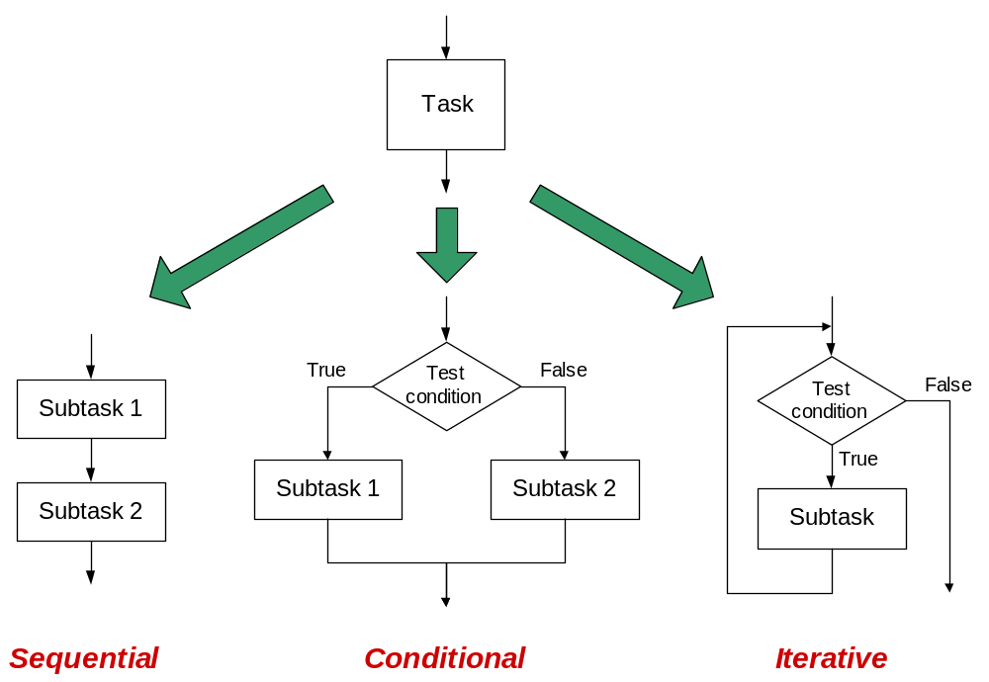
Three Basic Constructs
There are three basic ways to decompose a task:

Slide 6
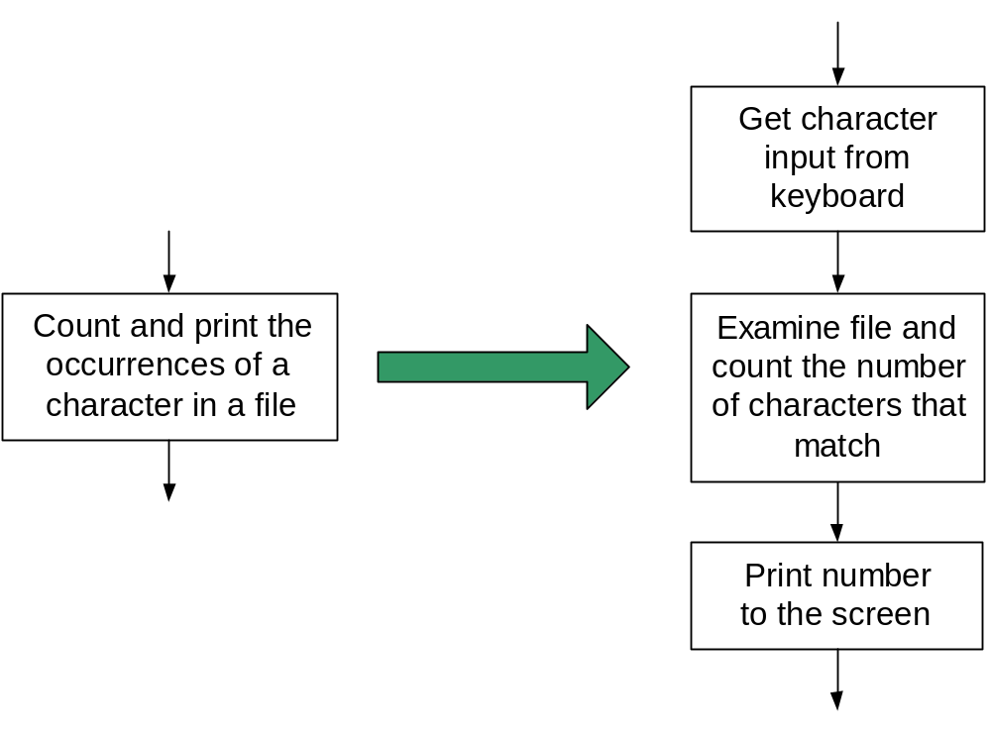
Sequential
Do Subtask 1 to completion,
then do Subtask 2 to completion, etc.

Slide 7
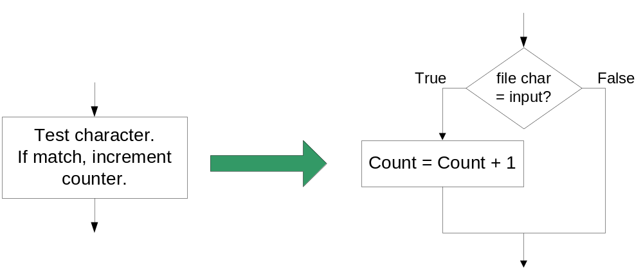
Conditional
If condition is true, do Subtask 1;
else, do Subtask 2.

Slide 8
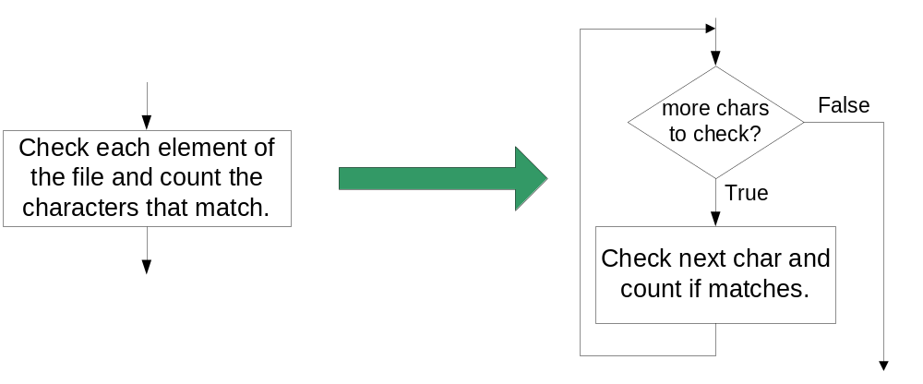
Iterative
Do Subtask over and over,
as long as the test condition is true.

Slide 9
Problem Solving Skills
Learn to convert problem statement
into step-by-step description of subtasks.
  Like a puzzle, or a “word problem” from grammar school math.
    What is the starting state of the system?
    What is the desired ending state?
    How do we move from one state to another?
  Recognize English words that correlate to three basic constructs:
    “do A then do B” ⇒ sequential
    “if G, then do H” ⇒ conditional
    “for each X, do Y” ⇒ iterative
    “do Z until W” ⇒ iterative

Slide 10
LC-3 Control Instructions
How do we use LC-3 instructions to encode
the three basic constructs?
Sequential
  Instructions naturally flow from one to the next,
  so no special instruction needed to go
  from one sequential subtask to the next.
Conditional and Iterative
  Create code that converts condition into N, Z, or P.
  Example:
  Condition: “Is R0 = R1?”
  Code: Subtract R1 from R0; if equal, Z bit will be set.
  Then use BR instruction to transfer control to the proper subtask.

Slide 11
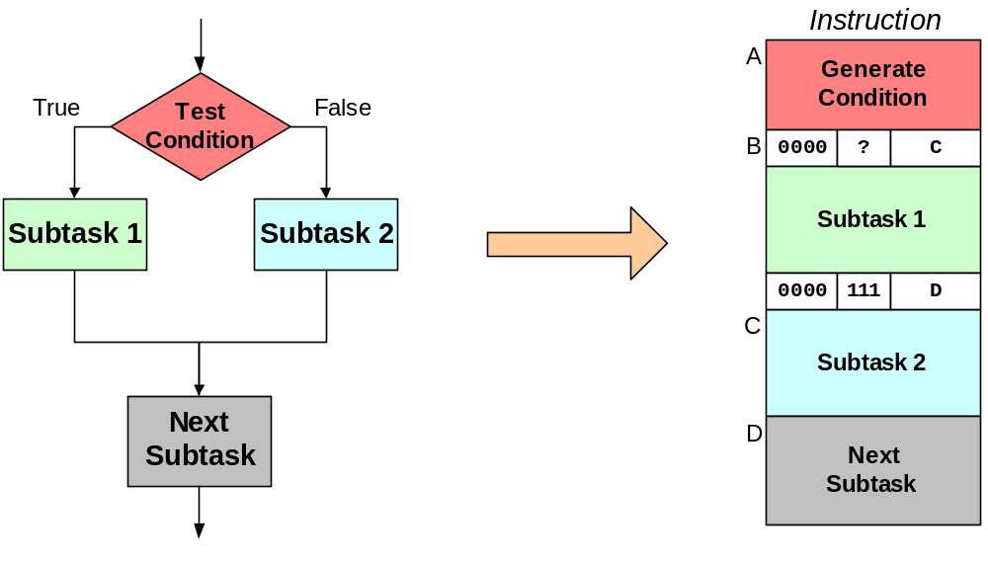
Code for Conditional
PC offset to
address C
Exact bits depend
on condition
being tested
Unconditional branch
to Next Subtask
PC offset to
address D
Assuming all addresses are close enough that PC-relative branch can be used.

Slide 12
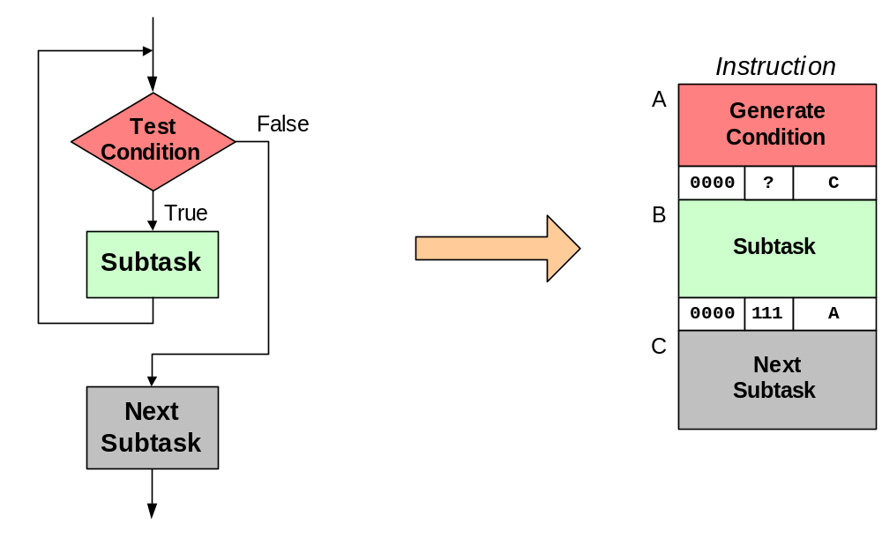
Code for Iteration
PC offset to
address C
Exact bits depend
on condition
being tested
Unconditional branch
to retest condition
PC offset to
address A
Assuming all addresses are on the same page.

Slide 13
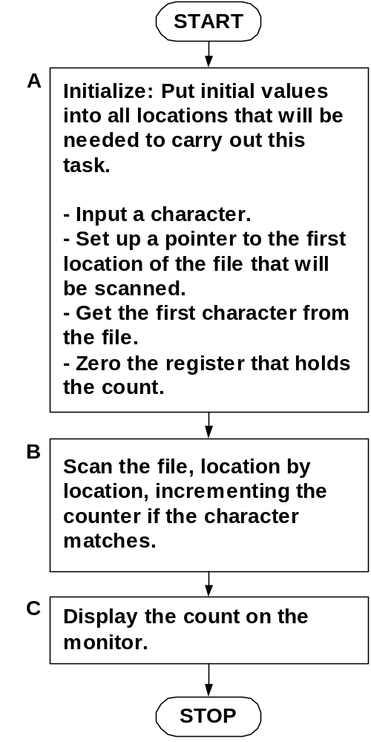
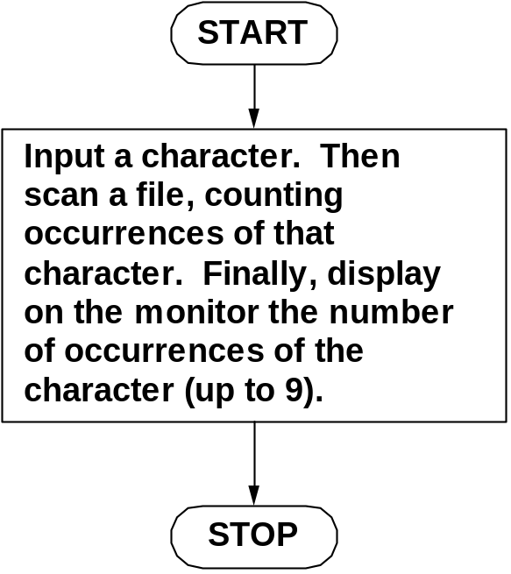
Example: Counting Characters
Initial refinement: Big task into
three sequential subtasks.

Slide 14
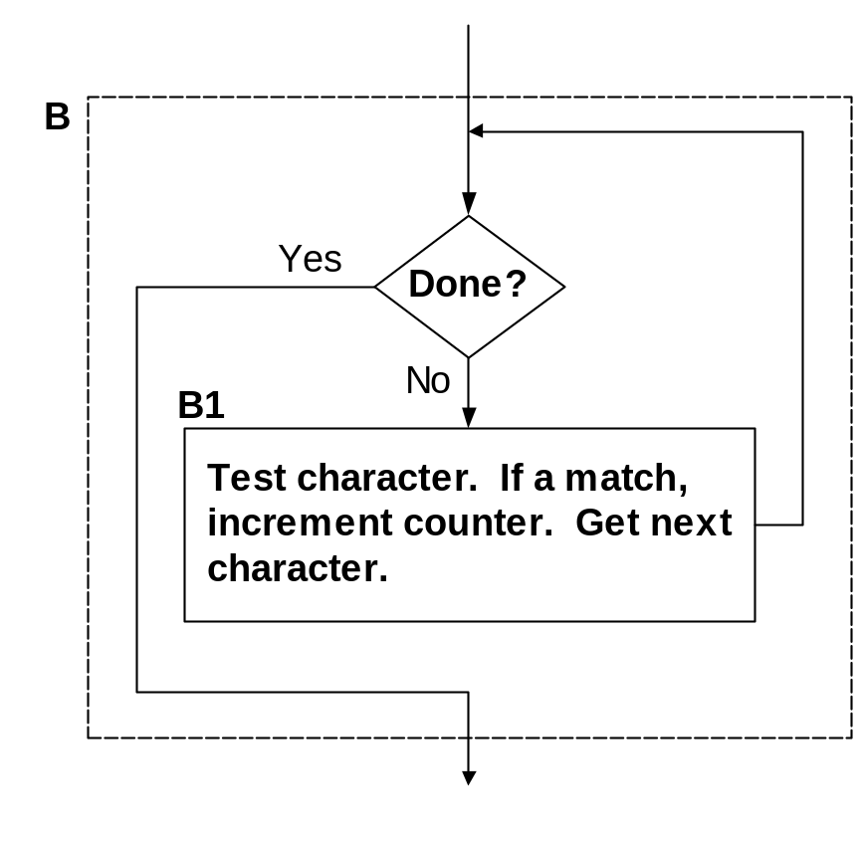
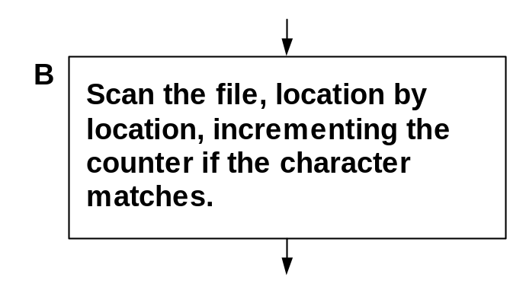
Refining B
Refining B into iterative construct.

Slide 15
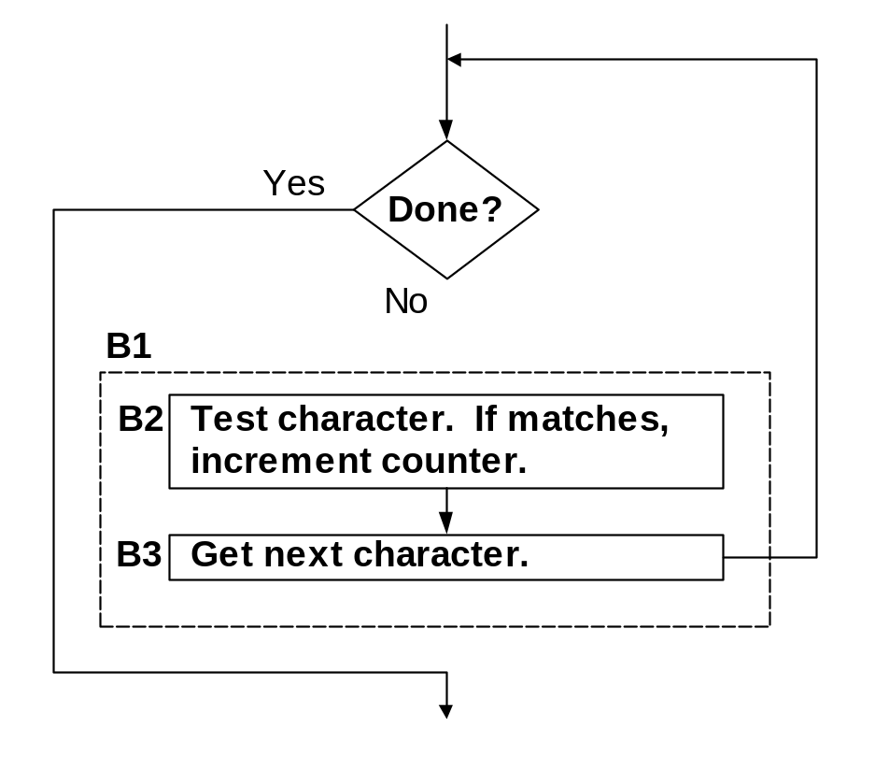
Refining B1
Refining B1 into sequential subtasks.

Slide 16
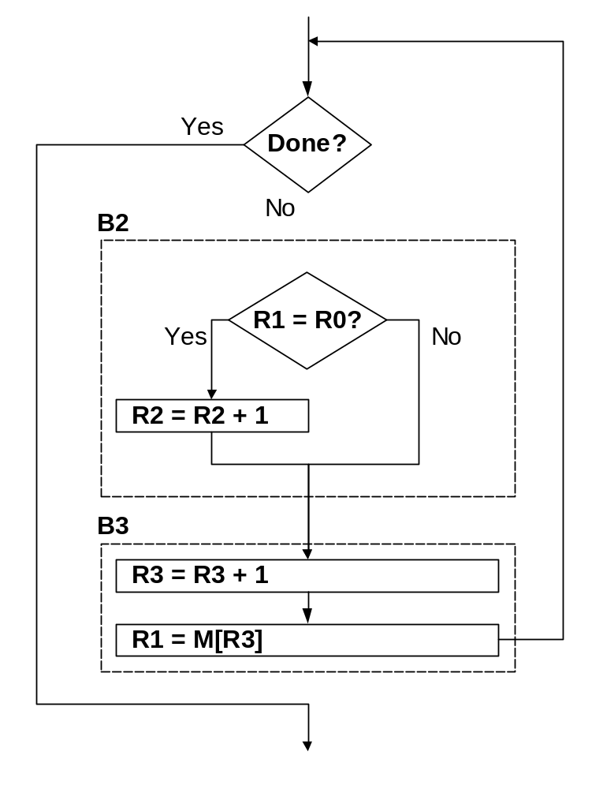

Refining B2 and B3
Conditional (B2) and sequential (B3).
Use of LC-2 registers and instructions.

Slide 17
The Last Step: LC-3 Instructions
Use comments to separate into modules and
to document your code.
; Look at each char in file.
0001100001111100 ; is R1 = EOT?
0000010xxxxxxxxx ; if so, exit loop
; Check for match with R0.
1001001001111111 ; R1 = -char
0001001001100001
0001001000000001 ; R1 = R0 – char
0000101xxxxxxxxx ; no match, skip incr
0001010010100001 ; R2 = R2 + 1
; Incr file ptr and get next char
0001011011100001 ; R3 = R3 + 1
0110001011000000 ; R1 = M[R3]
Don’t know
PCoffset bits until
all the code is done

Slide 18
Debugging
You’ve written your program and it doesn’t work.
Now what?
What do you do when you’re lost in a city?
  Drive around randomly and hope you find it?
  Return to a known point and look at a map?
In debugging, the equivalent to looking at a map
is tracing your program.
  Examine the sequence of instructions being executed.
  Keep track of results being produced.
  Compare result from each instruction to the expected result.

Slide 19
Debugging Operations
Any debugging environment should provide means to:
  Display values in memory and registers.
  Deposit values in memory and registers.
  Execute instruction sequence in a program.
  Stop execution when desired.
Different programming levels offer different tools.
  High-level languages (C, Java, ...)
  usually have source-code debugging tools.
  For debugging at the machine instruction level:
    simulators
    operating system “monitor” tools
    in-circuit emulators (ICE)
      plug-in hardware replacements that give
      instruction-level control

Slide 20
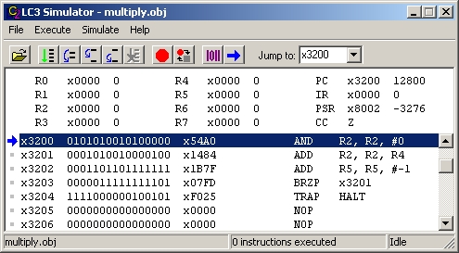
LC-3 Simulator
stop execution,
set breakpoints
execute
instruction
sequences
set/display
registers
and memory

Slide 21
Types of Errors
Syntax Errors
  You made a typing error that resulted in an illegal operation.
  Not usually an issue with machine language,
  because almost any bit pattern corresponds to
  some legal instruction.
  In high-level languages, these are often caught during the
  translation from language to machine code.
Logic Errors
  Your program is legal, but wrong, so
  the results don’t match the problem statement.
  Trace the program to see what’s really happening and
  determine how to get the proper behavior.
Data Errors
  Input data is different than what you expected.
  Test the program with a wide variety of inputs.

Slide 22
Tracing the Program
Execute the program one piece at a time,
examining register and memory to see results at each step.
Single-Stepping
  Execute one instruction at a time.
  Tedious, but useful to help you verify each step of your program.
Breakpoints
  Tell the simulator to stop executing when it reaches
  a specific instruction.
  Check overall results at specific points in the program.
    Lets you quickly execute sequences to get a
    high-level overview of the execution behavior.
    Quickly execute sequences that your believe are correct.
Watchpoints
  Tell the simulator to stop when a register or memory location changes
  or when it equals a specific value.
  Useful when you don’t know where or when a value is changed.

Slide 23
Example 1: Multiply
This program is supposed to multiply the two unsigned
integers in R4 and R5.
clear R2
x3200 0101010010100000
x3201 0001010010000100
x3202 0001101101111111
x3203 0000011111111101
x3204 1111000000100101
add R4 to R2
decrement R5
R5 = 0?
No
Set R4 = 10, R5 =3.
Run program.
Result: R2 = 40, not 30.
Yes
HALT

Slide 24
Debugging the Multiply Program
Single-stepping
PC | R2 | R4 | R5
x3200 | -- | 10 | 3
x3201 | 0 | 10 | 3
x3202 | 10 | 10 | 3
x3203 | 10 | 10 | 2
x3201 | 10 | 10 | 2
x3202 | 20 | 10 | 2
x3203 | 20 | 10 | 1
x3201 | 20 | 10 | 1
x3202 | 30 | 10 | 1
x3203 | 30 | 10 | 0
x3201 | 30 | 10 | 0
x3202 | 40 | 10 | 0
x3203 | 40 | 10 | -1
x3204 | 40 | 10 | -1
 | 40 | 10 | -1
Breakpoint at branch (x3203)
PC and registers
at the beginning
of each instruction
PC | R2 | R4 | R5
x3203 | 10 | 10 | 2
x3203 | 20 | 10 | 1
x3203 | 30 | 10 | 0
x3203 | 40 | 10 | -1
 | 40 | 10 | -1
Should stop looping here!
Executing loop one time too many.
Branch at x3203 should be based
on Z bit only, not Z and P.

Slide 25
Example 2: Summing an Array of Numbers
This program is supposed to sum the numbers
stored in 10 locations beginning with x3100,
leaving the result in R1.
R1 = 0
R4 = 10
R2 = x3100
x3000 0101001001100000
x3001 0101100100100000
x3002 0001100100101010
x3003 0010010011111100
x3004 0110011010000000
x3005 0001010010100001
x3006 0001001001000011
x3007 0001100100111111
x3008 0000001111111011
x3009 1111000000100101
R1 = R1 + M[R2]
R2 = R2 + 1
R4 = R4 - 1
R4 = 0?
No
Yes
HALT

Slide 26
Debugging the Summing Program
Running the the data below yields R1 = x0024,
but the sum should be x8135. What happened?
Address | Contents
x3100 | x3107
x3101 | x2819
x3102 | x0110
x3103 | x0310
x3104 | x0110
x3105 | x1110
x3106 | x11B1
x3107 | x0019
x3108 | x0007
x3109 | x0004
Start single-stepping program...
PC | R1 | R2 | R4
x3000 | -- | -- | --
x3001 | 0 | -- | --
x3002 | 0 | -- | 0
x3003 | 0 | -- | 10
x3004 | 0 | x3107 | 10
Should be x3100!
Loading contents of M[x3100], not address.
Change opcode of x3003
from 0010 (LD) to 1110 (LEA).

Slide 27
Example 3: Looking for a 5
This program is supposed to set
R0=1 if there’s a 5 in one ten
memory locations, starting at x3100.
Else, it should set R0 to 0.
x3000 0101000000100000
x3001 0001000000100001
x3002 0101001001100000
x3003 0001001001111011
x3004 0101011011100000
x3005 0001011011101010
x3006 0010100000001001
x3007 0110010100000000
x3008 0001010010000001
x3009 0000010000000101
x300A 0001100100100001
x300B 0001011011111111
x300C 0110010100000000
x300D 0000001111111010
x300E 0101000000100000
x300F 1111000000100101
x3010 0011000100000000
R0 = 1, R1 = -5, R3 = 10
R4 = x3100, R2 = M[R4]
R2 = 5?
Yes
No
R3 = 0?
R4 = R4 + 1
R3 = R3-1
R2 = M[R4]
No
Yes
R0 = 0
HALT

Slide 28
Debugging the Fives Program
Running the program with a 5 in location x3108
results in R0 = 0, not R0 = 1. What happened?
Perhaps we didn’t look at all the data?
Put a breakpoint at x300D to see
how many times we branch back.
Address | Contents
x3100 | 9
x3101 | 7
x3102 | 32
x3103 | 0
x3104 | -8
x3105 | 19
x3106 | 6
x3107 | 13
x3108 | 5
x3109 | 61
PC | R0 | R2 | R3 | R4
x300D | 1 | 7 | 9 | x3101
x300D | 1 | 32 | 8 | x3102
x300D | 1 | 0 | 7 | x3103
 | 0 | 0 | 7 | x3103
Didn’t branch
back, even
though R3 > 0?
Branch uses condition code set by
loading R2 with M[R4], not by decrementing R3.
Swap x300B and x300C, or remove x300C and
branch back to x3007.

Slide 29
Example 4: Finding First 1 in a Word
This program is supposed to return (in R1) the bit position of the first 1 in a word. The address of the word is in location x3009 (just past the end of the program). If there
are no ones, R1 should be set to –1.
R1 = 15
R2 = data
x3000 0101001001100000
x3001 0001001001101111
x3002 1010010000000110
x3003 0000100000000100
x3004 0001001001111111
x3005 0001010010000010
x3006 0000100000000001
x3007 0000111111111100
x3008 1111000000100101
x3009 0011000100000000
R2[15] = 1?
Yes
No
decrement R1
shift R2 left one bit
R2[15] = 1?
No
Yes
HALT

Slide 30
Debugging the First-One Program
Program works most of the time, but if data is zero,
it never seems to HALT.
Breakpoint at backwards branch (x3007)
PC | R1
x3007 | 14
x3007 | 13
x3007 | 12
x3007 | 11
x3007 | 10
x3007 | 9
x3007 | 8
x3007 | 7
x3007 | 6
x3007 | 5
PC | R1
x3007 | 4
x3007 | 3
x3007 | 2
x3007 | 1
x3007 | 0
x3007 | -1
x3007 | -2
x3007 | -3
x3007 | -4
x3007 | -5
If no ones, then branch to HALT
never occurs!
This is called an “infinite loop.”
Must change algorithm to either
(a) check for special case (R2=0), or
(b) exit loop if R1 < 0.

Slide 31
Debugging: Lessons Learned
Trace program to see what’s going on.
  Breakpoints, single-stepping
When tracing, make sure to notice what’s
really happening, not what you think should happen.
  In summing program, it would be easy to not notice
  that address x3107 was loaded instead of x3100.
Test your program using a variety of input data.
  In Examples 3 and 4, the program works for many data sets.
  Be sure to test extreme cases (all ones, no ones, ...).

